Slide 1
Module 9 - Tailoring your written sales to get a yes!

Slide 2
How do the webinars work?
1.5 hours of training content
Every month we will cover a different topic
We will use the chat room, Miro boards and live discussion. There will be group work when appropriate and the numbers allow – so get involved!
We do need to see each others faces! Unless I explain otherwise e.g. if we have a lot of content to get through and we are running out of time
I will always ask you for questions
I will always ask for your full attention
You will always have mine
We will respect the confidentiality of our clients, candidates and colleagues

Slide 3
Objectives for this session:
Understand the science of persuasion
Understand what grabs readers attention and make them want to read on
How to make yourself stand out in a crowded market place
To understand that getting a no is on the journey to getting a yes
To know how to tailor your written sales for individuals

Slide 4
By the end of this session you will be able to: Write an attention grabbing introduction email Write an inmail that gets a response Write a follow up email that’s gets a response Post session activity - Write a speccing email for your candidates

Slide 5
What is the science of persuasion?

Slide 6
Recriprocity
Personalised
Unexpected
Be the first to give!

Slide 7
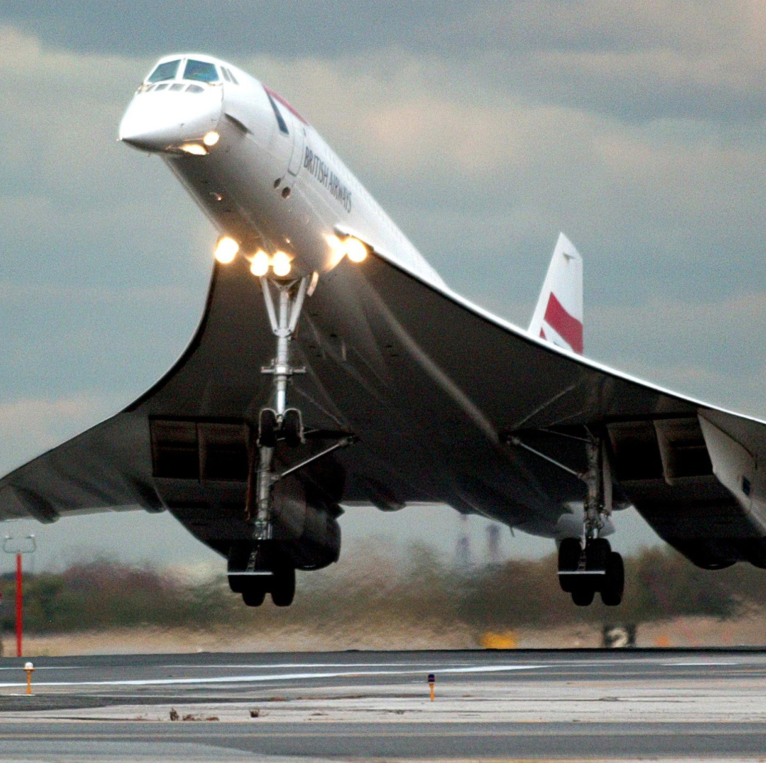
Scarcity
What are the benefits?
What is unique?
And what can they lose?

Slide 8
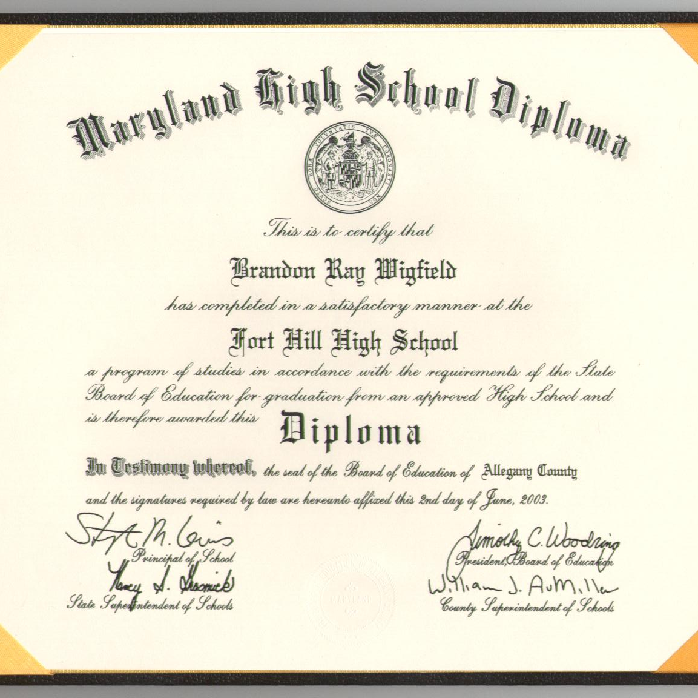
Authority
You need to get other people to say it for you
E.g. LinkedIn testimonials

Slide 9
Consistency
Voluntary
Active
Public commitment – in writing
Small yes’s lead to bigger ones!

Slide 10
Liking
Similar
Compliments
Cooperate towards mutual goals
Find mutual interests

Slide 11
Consensus
How can we do this?
What are others already doing/ similar others?
How can this link to you/ your business/ your role?
E.g. clients
Candidates

Slide 12
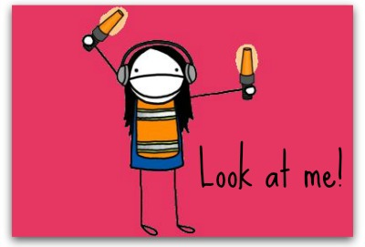
Understand what grabs readers attention and make them want to read on
Honesty!
One main message of your email – these needs to go in your subject header
What has worked for you?

Slide 13
Opening with Impact: Creating a Capability Statement
Authority – What are you in charge of?
Credibility – Why are you great?
Likability – Why should they like you?
Interest – What do you know?
Curiosity – What do you want to find out?
Beneficial – How can you benefit them?
Relevance – How are you relevant to them?
Individual – How do I know this isn’t a generic approach?
Notes:
I will put some examples in the members area

Slide 14
What do we need to include?
Hi I’m Ali Braid and I am the Director of Recruit Direct. I work with clients across the a space and am working on a number of roles within x – I understand this is a busy area within x business’s at the moment and wondered how your team was faring at the moment?
Hi My name is Ali Braid and I am the owner of Recruit Direct. I have worked with (competitors) x and y in the last few months on x and I wondered how x was affecting you. What my clients are finding at the moment is… how has it been for you?

Slide 15
Writing effective Inmails
Your Inmail is a conversation starter
NOT a way to bring in new jobs……yet
What was it about their profile that prompted you to get in touch?
Write as you would speak to someone on the phone
Express how you want to help THEM, not the other way round
Be brief and succinct
Ask about their career path and goals
Don’t cut and paste a job spec if to a candidate
Ask a question to create a reason to reply

Slide 16
Lets have a go…
Have a go at writing an Inmail now – or share one that has had a positive response!

Slide 17
95% of all sales people make the 1st sales call
50% of all sales people make the 2nd sales call
25% of all sales people make the 3rd sales call
15% of all sales people make the 4th sales call
10% of all sales people make the 5th sales call
Just 5% make that 6th call and they take 85% of the new business available in any market!

Slide 18
How to make yourself stand out in a crowded market place?
FOLLOW UP! Can you hear me at the back?!
Be that 5% of recruiters!
How do you follow up?
The important part of the follow up is…..

Slide 19
TO JUST DO IT!!

Slide 20
Silence is not a response!
It is not a no
It is not a maybe
It is not a yes
But it could be a –not yet!
So carry on.. You may need at least 7 attempts to get a response – it could be as many 15….
Silence never means what you think…

Slide 21
Have you created a touch plan?
If you haven’t done this – I recommend it!
A 12 point plan for each client
e.g.
Call intro
Email intro
Inmail and connection
Whitepaper
Call
CV spec
Call
Share market knowledge

Slide 22
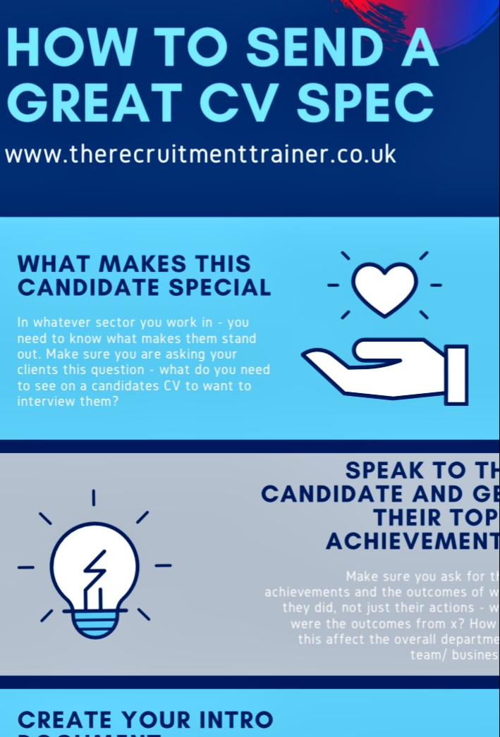
Have you asked your clients what grabs THEIR attention?
What is your advice for writing a stand out CV spec email?
Separate document or within the text?
How much white space?
What achievements and projects do you mention?
Always keep the reader in mind (it’s not about us..)

Slide 23
Top tips for effective written sales:
Use your client Avatars!
Create a 12 point touch plan
Think about the method and message
Keep it simple
Be honest
Develop a relationship, don’t sell too soon – DSTS!
Remember its what they want – its not about us
Write how your would speak for a natural tone
Be consistent and follow up, even when you get silence

Slide 24
Follow up learning:
Watch the video on the Science of Persuasion
Read the “How to send a great CV spec” and create your own – send to Ali for feedback
Read Mitch Sullivan post and do your own research on emails…
Read the LinkedIn Inmail suggestion (you will get the link)

Slide 25
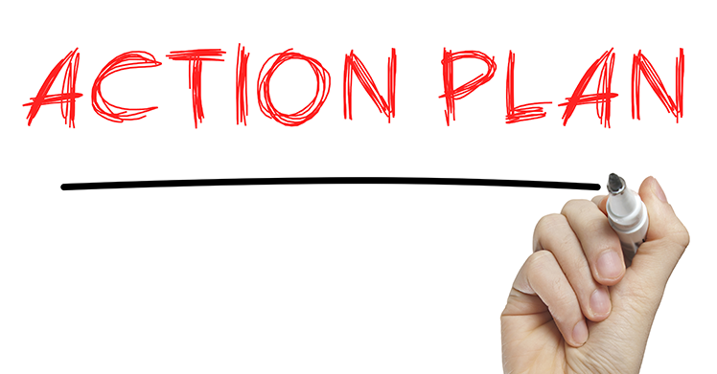
Drop in will be on Wednesday 19th at the later time of 1:45 -2:45 p.m.
If you would like to book your 30 minute call for May do get in touch so we can diarise it for you
We will talk through your wins, what you can use from this masterclass going forward and discuss your Q2 goals.
Your actions are to think about –
What will you try and use after this session?
What is your 1 commitment? Write it on your action plan
Module 10 Action plan will be added to the members area

