Slide 1
Session 2
It’s all about your Strategy!

Slide 2
House rules
1.5 hours of training content
Every month will have a different topic
We will have one comfort break of 5 minutes!
We will use the chat room, Miro boards and live discussion. There will be group work when appropriate and the numbers allow – so get involved!
We do need to see each others faces! Unless I explain otherwise e.g. if we have a lot of content to get through and we are running out of time
I will always ask you for questions
I will always ask for your full attention
You will always have mine
We will respect the confidentiality of our clients, candidates and colleagues

Slide 3
What is my strategy?
How should I map my market?
How should I plan?

Slide 4
Why do 95% recruiters fail in sales?
Failure to build a specific market niche
Failure to identify multiple points of contact
Failure to set multiple objectives for calls
Failure to Listen – Be Interested, not Interesting
Failure to follow the KLT’s
Failure to follow up

Slide 5
What is my strategy?
Large Business
Medium Sized Business
Medium Sized Business
Medium Sized Business
Medium Sized Business
Medium Sized Business
Who to target?
Hub and Spoke model…
Number of points of contact
Speed of sales process
Decision making
ROI
Number of vacancies
Repeat business
Nature of the relationship

Slide 6
IV Lead
Which companies should I target?
Dormant
Cross sell
Lapsed
Similar
Existing
Active contractor sites
Tracking active candidates
Which of these do you get in touch with regularly?
How often do you call them?
Do you need to up it? Does it need to be less often?
What reasons do we have to call them?
What other candidate “stars” would you add to the above?

Slide 7
‘Head of/Director’
CTO
MD
‘Senior Manager’
‘Reception, HR, Recruitment & Candidates
Who should I target?
The MAN
Potential candidates/ non MAN

Slide 8
Know –like- trust
People buy from people that they like, that are like them and that like them.
What are your friends like?
What are your clients like?
What are your candidates like?

Slide 9
Client avatars
Title – Background – age – gender - Profession
Quick – Slow
Lots of speech – Little
Detail – Big picture
External – Internal
Pictures – Facts
Lots of written – Bulletpoints
Personal – Professional
Emotional - Logical
Emotional - Logical

Slide 10
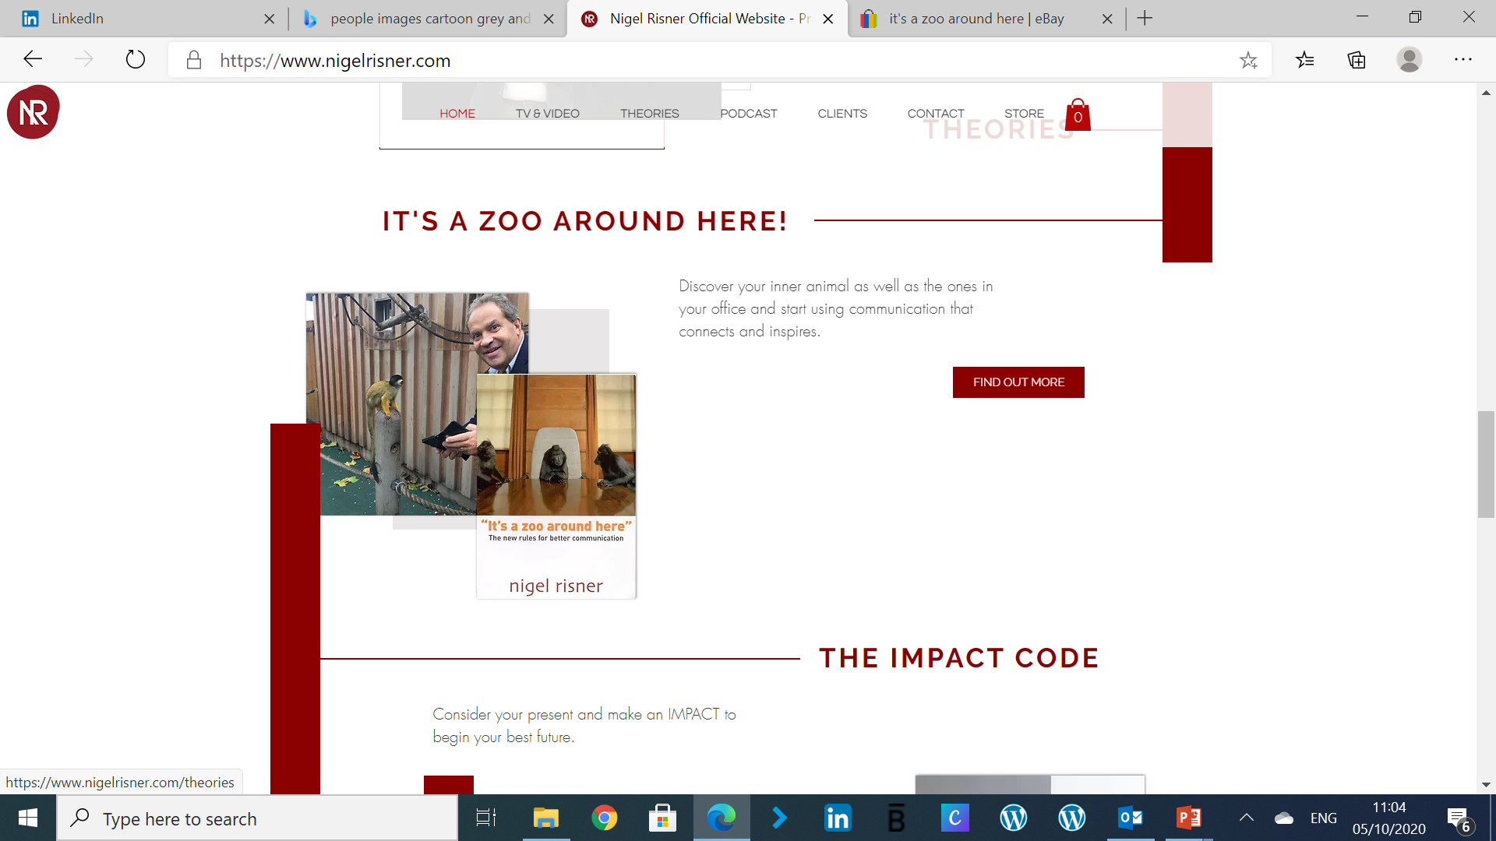
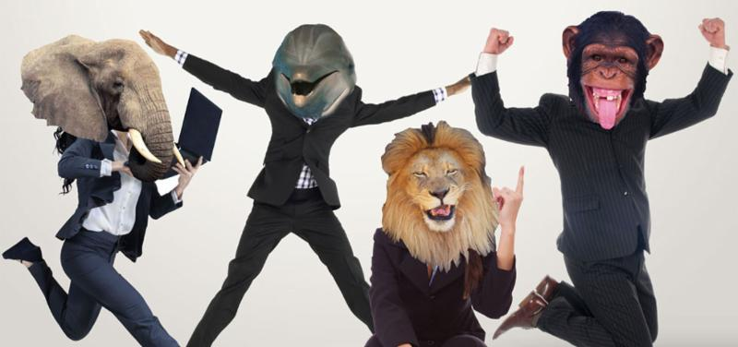
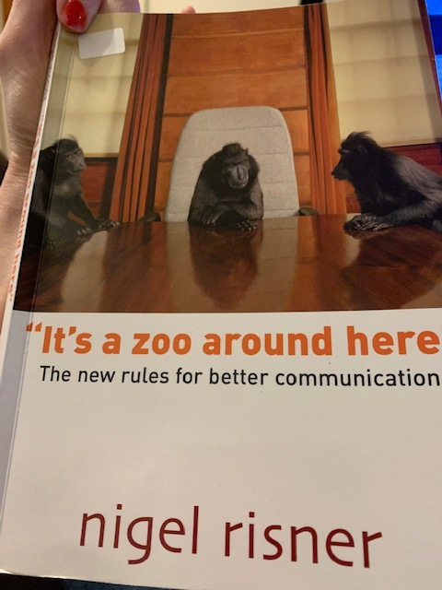
What animal are you? What animal is your client and candidate?
Lion – Direct and guarded
Monkey – Open and direct
Dolphin – Open and indirect
Elephant – Indirect and guarded

Slide 11
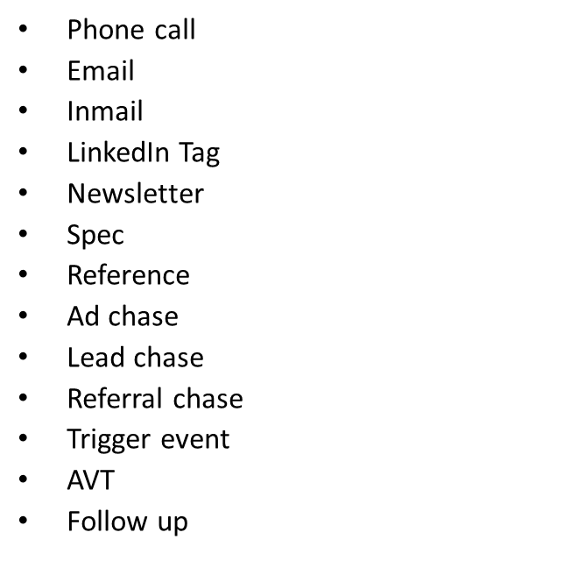
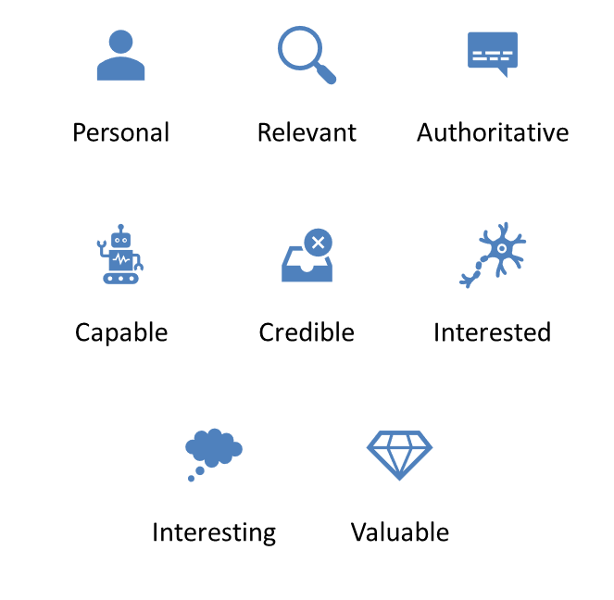
Choose your method and message
Method
Message

Slide 12
Selling in the way they want to buy
Looking at/ thinking about one of your client Avatars now – in the chat box have a go at answering these questions:
How does this inform HOW they want to buy?
Over the phone? On email? In a text? Or will there be a combination of these?
How can you test this?
Why do we want to test this? How much of the rock have you chipped away?

Slide 13
How can you organize your contacts?
Spreadsheet/Tracker
CRM
Hotlists
Diary/Reminder System
LBB!!

Slide 14
How should I plan?
Daily
Weekly
Monthly
Quarterly
Most clients need between 8-15 “touches” before they will work with you.
You can plan your touches using the method and message technique.
Organise your contacts/ live roles based on - QUIC

Slide 15
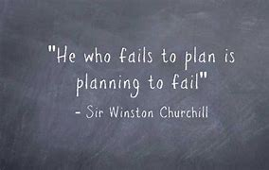
We will have our next drop in w/b 19th Oct
40 minutes - Come with your questions on planning, strategy, your client avatars, how to use QUIC… etc…
Your actions are to think about –
What will you try and use after this session?
What is your 1 commitment? Write it on your action plan
How will you categorise your clients?
Send me your client avatars for at least 2 clients – think about the method, message and how they want to be communicated with. You can also add your touch points if you have time….

