Slide 1
Module 3
How to make your BD calls count!
Oct 2020

Slide 2
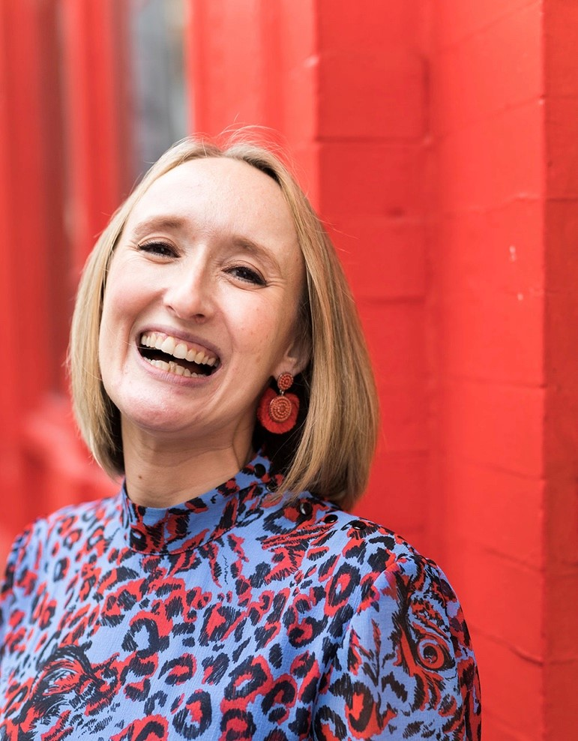
17 years industry experience
Welcome!
Consultant
Senior consultant
L and D consultant
Internal Recruitment Manager
Associate Director
Director of Operations
Training Consultancy owner
But this group is all about and for you!
Notes:
Also worth mentioning I did BD for 5 years, 4 days a week, 6 hours a day. BD hasn’t changed too much – in terms of how we approach the phone, and what worked then, still works.

Slide 3
How does the RAC work?
How will Ali support me?
Week 1 – Webinar, interactive – share ideas and ask questions
Week 2 – Catch up with Ali on wins and challenges/ watch pre-recorded video/ other training material
Week 3 – Drop in clinic
Week 4 - Update Action plan, agree next steps

Slide 4
How do the webinars work?
1.5 hours of training content
Every month we will cover a different topic
We will have one comfort break of 5 minutes!
We will use the chat room, Miro boards and live discussion. There will be group work when appropriate and the numbers allow – so get involved!
We do need to see each others faces! Unless I explain otherwise e.g. if we have a lot of content to get through and we are running out of time
I will always ask you for questions
I will always ask for your full attention
You will always have mine
We will respect the confidentiality of our clients, candidates and colleagues

Slide 5
Objectives:
What objectives to set before a call
How to open your calls with impact
How to qualify your clients quickly and efficiently
How to make sure you are selling effectively
How to close with commitment from the client

Slide 6
SETTING OBJECTIVES FOR YOUR CALLS
Why is this important? Use SMART Specific Measurable Achievable Realistic Time -based

Slide 7
Use SMART objectives
What more do you know about that business/ department/ team/ manager?
Do you know more than before you picked up the phone?
You need to be honest with yourself!
Otherwise you will not improve or be able to track your progress
HOW DO YOU MEASURE SUCCESS?

Slide 8
What is your battle plan? Recap of Module 2
Find your niche and stick to it
Identify 100 -150 target clients
List all existing, lapsed, cross-sell, similar
Identify the correct points of contact
Profile your target clients
Create your client avatars
Choose wisely the methods and messages
Create a bespoke and a broadcast strategy
Sell what they want to buy
Communicate in their way, not yours
‘Wear them down over a period of time, but in a really nice way’
Create consistency
Be persistent
BD is a daily activity, like brushing your teeth!
Test & Re-Test!

Slide 9
Using influential language
Why is the language you use so important?
Make sure it is:
Positive
Emotional
Use the word “you”
The power of the word “help”
Positive assumptives
In my experience…
My other clients say…
My recommendation is…
My suggestion in this scenario is…
I want to help you find a solution
What I have found really helped another client was..

Slide 10
Why do we ask questions?
To encourage thinking
To confirm and gain agreement
To probe for further clarification
To close on our objective(s)
To gain information & to establish facts
Notes:
Why do we need questions?
In recruitment there is no such thing as magic answers – But we do have magic questions. Questions have a strange quality – You cannot respond to a question without firstly thinking of an answer. Even with the answer ‘I don’t know’ you would still have to think through your knowledge and past experience to come up with that answer.
We have been programmed to ask closed questions over a period of time. This leads to limited conversation, and limited information gathering. As information gatherers by trade, we have to re-programme our brains into asking more effective questions in order to promote deeper thought, drill down into hidden needs/wants/issues and to influence our clients and candidates.
Clients (and some candidates) may be less receptive and open to talking to you – The right questions can mean the difference between that client or candidate talking to you ... Or not!
Lets take a look at the different types of questions... As we go through these, please make a note of which types of questions you and the other person were mostly using during the exercise...

Slide 11
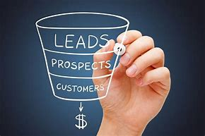
THE SALES STRUCTURE
Information gather
Establish needs
Confirm needs
Business decision
Match needs
Sell the benefits
Anything else?
Close
Notes:
This is on the members area

Slide 12
Building Conversations
Question
Asking open and demand questions to gain information
‘Who, what, where, when, why, tell me, describe, explain’
Answer
Receiving the answer and actively listening
Listening for empathy clues, learning style, hidden needs/wants/tone of voice/pacing
Empathy
A statement of shared opinion, fact, a short story, or a shared experience (feel/felt/found)
This sharing improves the chances of them then answering another question
Question
Answer
Empathy
We continue with this structure throughout the conversation
The more we do it, the more open the conversation becomes
The more open the conversation becomes, the more chance we have to spot problems to solve or needs to remedy
The more we can ‘match’ the other person and build rapport (KLT)
Notes:
Building rapport and creating relationships is a 3 stage process: The recipient needs to –
Know you
Like you
Trust you
The more interesting (shared intelligence), interested (asking questions) and similar to them (matching) you are, the quicker this will happen

Slide 13
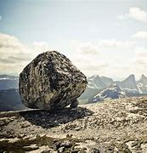
Setting multiple approach objectives – What to do if they say no
Have your information gathering questions prepared
Imagine what you want – i.e. live roles, is inside this rock.
You need to chip away at it
What questions will you
need to chip your way through to the centre?
You can ask about – them, their role, the business,
recruitment, agency usage, skills they need….
If they say no – where will you go next?

Slide 14
Always start with the end in mind
What shall I say to get into it?
What will they throw at me to stop me?
How will I respond?
How will I close?
What do I want out of it?

Slide 15
Opening your calls with impact
Think about this – when the client puts the phone down – what do you want them to remember about you?
How do YOU want to be perceived? In control, confident, professional….
And how will this generate business?

Slide 16
Opening with Impact: Creating a Capability Statement
Authority – What are you in charge of?
Credibility – Why are you great?
Likability – Why should they like you?
Interest – What do you know?
Curiosity – What do you want to find out?
Beneficial – How can you benefit them?
Relevance – How are you relevant to them?
Individual – How do I know this isn’t a generic approach?
Notes:
I will put some examples in the members area

Slide 17
How to qualify your clients
What questions should we be asking to qualify them?
What does “qualify” mean?

Slide 18
Selling effectively
How can we make sure we are hitting the mark?
What are your tips for selling effectively?
Can we still sell in the current market?
What is the out come if we don’t?

Slide 19
Selling in Benefits
Feature
Advantage
Benefit
Quantifiable evidence of achievements
Testimonials
Statistics or Figures
Accreditations or Qualifications
Awards
Rankings
WIIFM?

Slide 20
SPIN Selling – Neil Rackham

Slide 21
SPIN Selling
Turning continuations in to advances:
Neil Rackham talks about measuring larger sales in terms of advances and continuations.
The difference between these is having a specific, and usually concisely worded, objective for you call.
For example - having the call objective of - I am going to do some info gathering, is too generic and will not move the sale forward.
That is a continuation and will not get you closer to working with that client. (remember the role in the rock)
Having a call objective of - Getting feedback on a candidates CV and agreement to a Zoom call - This is an advance as it involved a positive action towards working with that client.
When planning your problem questions - try and think if these are helping you meet your call objectives and make sure that they are advancing the relationship.

Slide 22
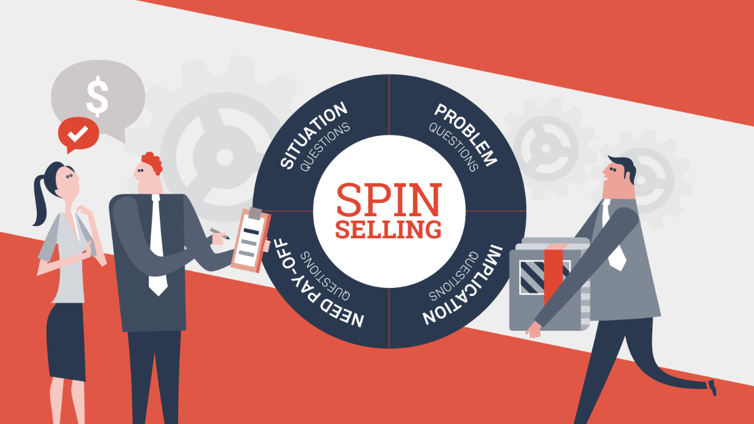
SPIN selling – how do we use this?
Which of these are continuation objectives?
Which of these are advance objectives?
To build a relationship
get 3 new MAN contacts
Get agreement for the next call
book a zoom/f2f meeting
Agree on exclusivity
keep in touch
Feedback on a cv
answer some research questions
Involved in company podcast
work on the next live role

Slide 23
Don’t
Sell what you want to sell
When you want to sell it
How you want to sell it
To the people you want to sell to

Slide 24
What could commitment from the client look like?
How to close effectively and gain commitment
Remember your objectives for the call
What happens if we don’t close the call effectively?
WHY is closing the call well so important?

Slide 25
Remember the Sales Structure:
Close – there needs to be an action, and it needs to be yours.
“Thank you for your time today, I will ring you in a few weeks..”
“I will send you an email so you have my contact details…”
“I will speak to those candidates I mentioned and call you this afternoon, how is 3p.m.”
“I know you are not looking to recruit for a few months however I will keep in touch… “
Get an email address, a direct line.
Give them your number.
Effective closing phrases

Slide 26
How to get commitment
Option 1
Option 2
Option 3
Based on what we have talked about today – is there any reason why you couldn’t come to me next time you are hiring?
No not at all – great! What in particular makes you feel confident to use me?
Would you feel comfortable in working together next time you are recruiting?
If they say yes – great – what have I said today that makes you feel comfortable enough…
Will you come to me next time?
Will you ring me first?
If they say – yes – Great! Why will you?
Notes:
And if they say no – ask why?
What else do I need to do?

Slide 27
Questions?

Slide 28
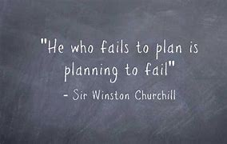
We will have our next drop in w/b 16th November
45 minutes - Come with your questions on your pitch, your information, selling effectively, using SPIN…
In the meantime – we will book in for a 20 mins catch up next week…
Your actions are –
What will you try and use after this session?
What is your 1 commitment? Write it on your action plan
Do you need to write a new pitch?
What questions are you asking your clients and are they keeping you close to the money?
What close will you try?
Look at the new resources on the members area! SPIN selling, client leads and candidate maximisation

